Slide 1

CoderDojo Bray
Introduction to Programming
Sessions 1-6: Scratch

Slide 2
Get set up
Join wireless network: coderdojo<x> where <x> is your table number
If doing Scratch, have you got Scratch installed?
Any problems:
1. Ask another kid
2. Ask another kid
3. Ask another kid
4. If you really need to, ask a mentor

Slide 3
Sessions 1-6 on Scratch What will you do today?
We’ll show you a few ideas, tips and tricks
Then you can start experimenting and work on your own projects
Making things fall like gravity (download and edit/copy)
Diving Deeper challenges: some things for you to try

Slide 4
Use the online materials
Open Chrome and type in the address box: http://goo.gl/zn4XC
Look in the Week 4 folder
Contains all the handouts from previous weeks
Copy a project, finish it, then move to the next one
Plus Diving Deeper Challenges
Pick one and try it
Get help mostly from the kids on your table
Take a break for a few minutes at 3.30

Slide 5
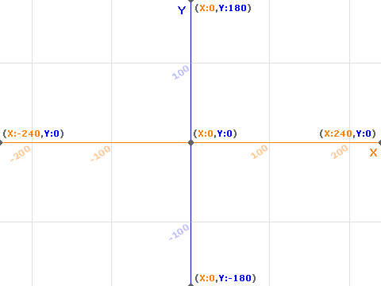
Scratch ‘stage’: Position is X (across) and Y (up)

Slide 6
Next Week
Keep practising and experimenting
Learn more, enjoy the process
Work together / help each other
Improve your Scratch projects
Share your projects on the web at http://scratch.mit.edu

